Slide 1
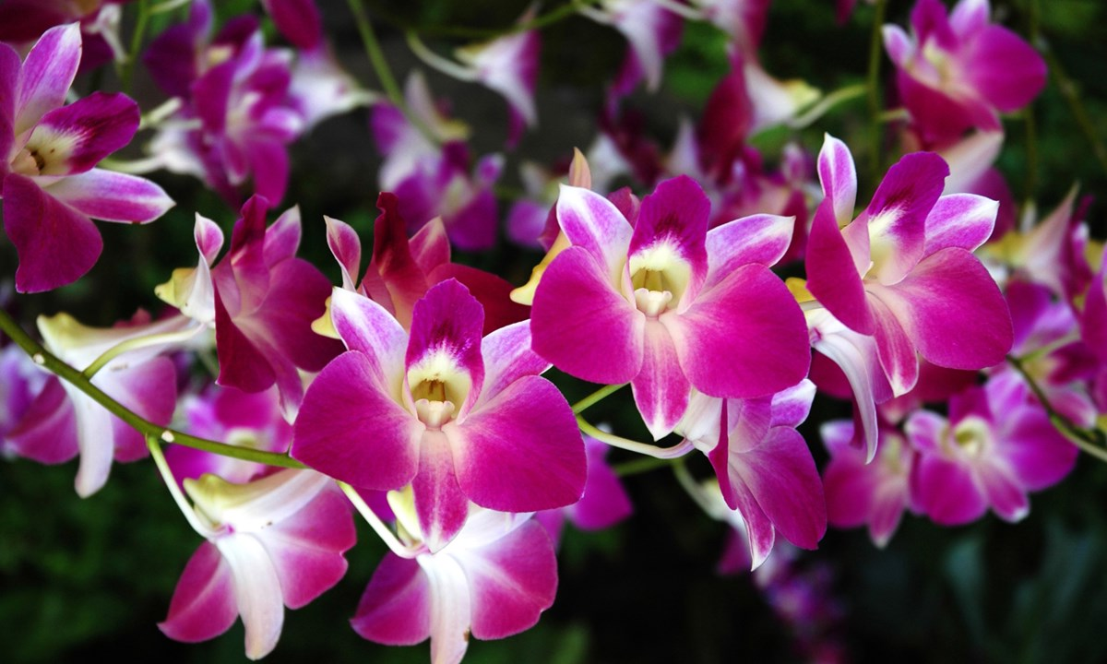

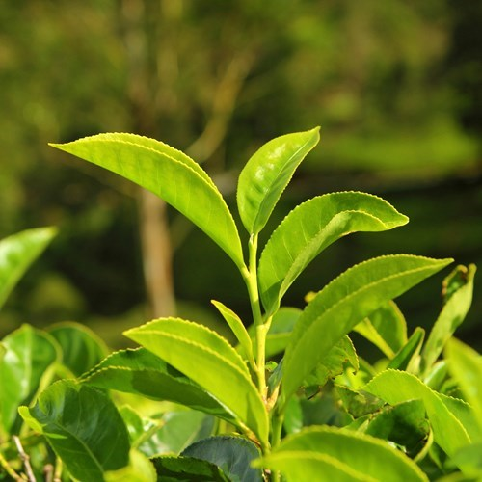
DEPT. OF BOTANY
Open course –
APPLIED BOTANY

Slide 2
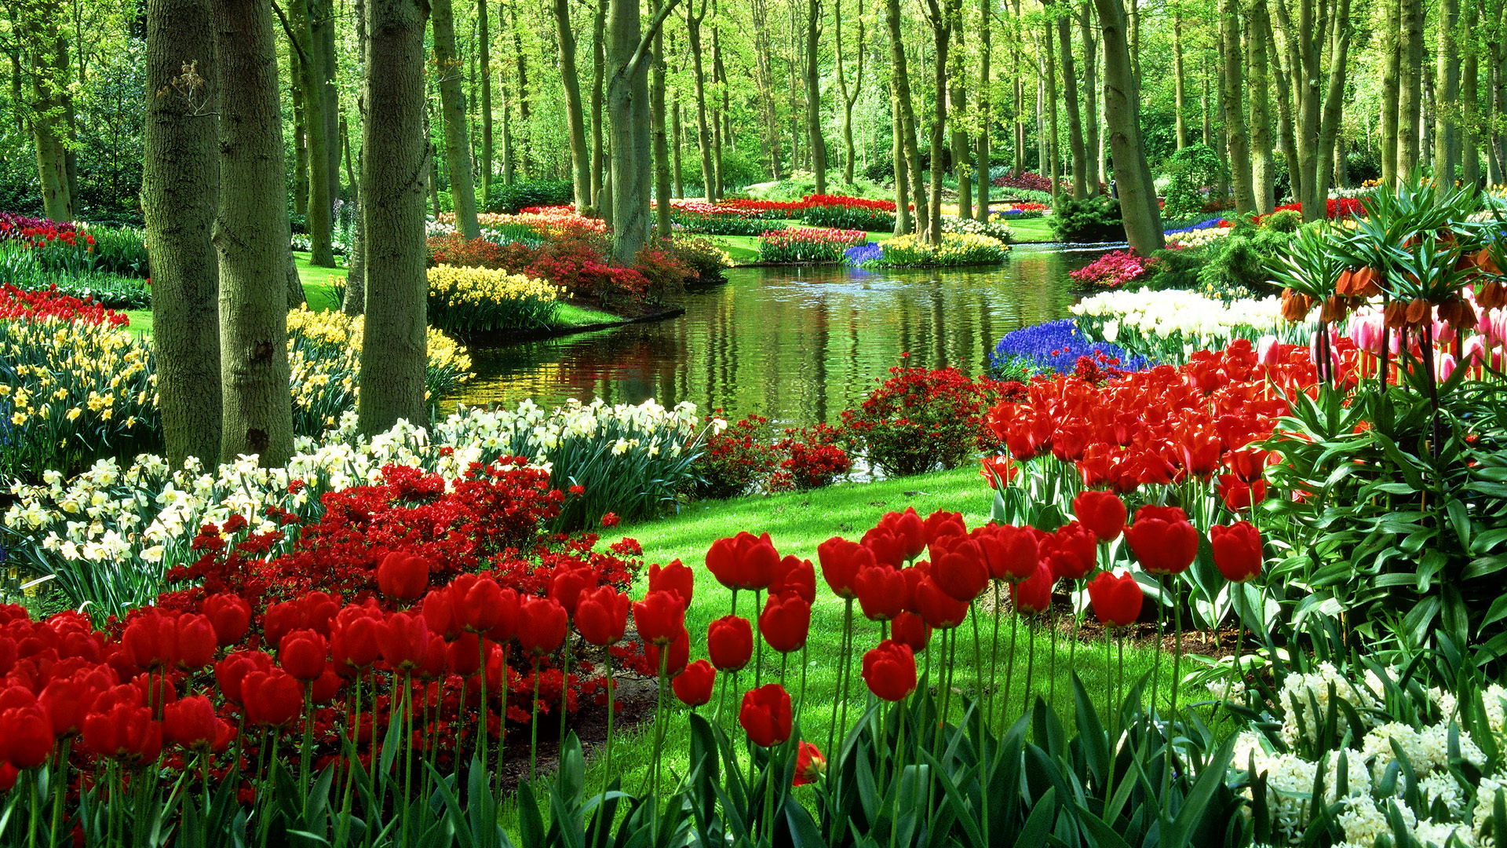

Slide 3
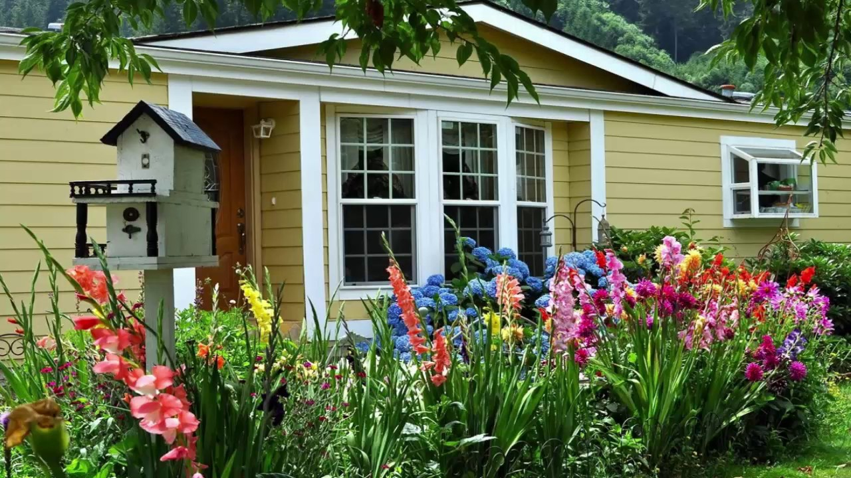

Slide 4
STEPS OF GROWING PLANTS
Soil
Pots & Potting
Chemical fertilizers
Organic manure
Irrigation
Plant protection

Slide 5
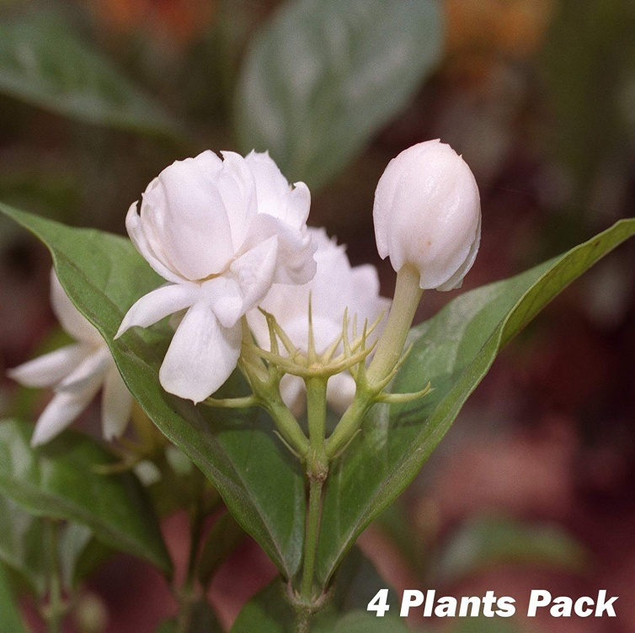
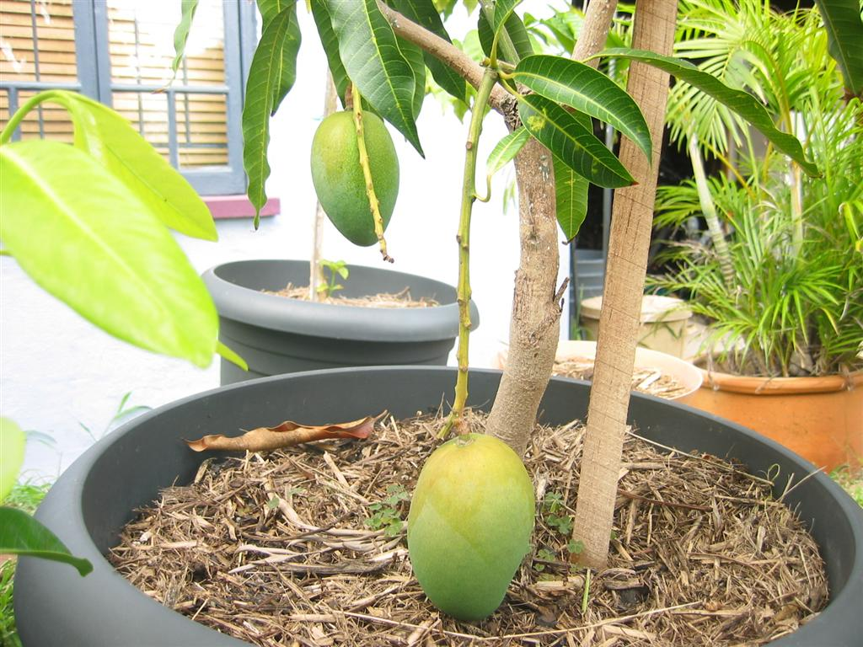

Slide 6
VEGETATIVE PROPAGATION:
(a) Cutting
(b) Grafting
(c) Budding
(d) Layering
MICROPROPAGATION

Slide 7
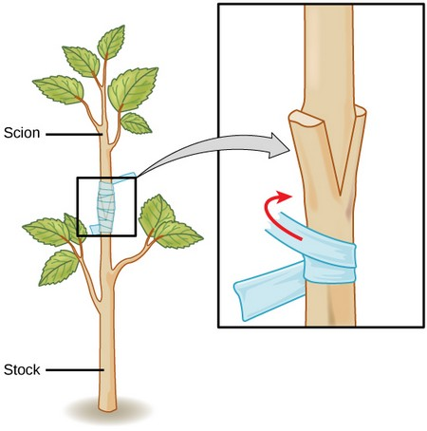
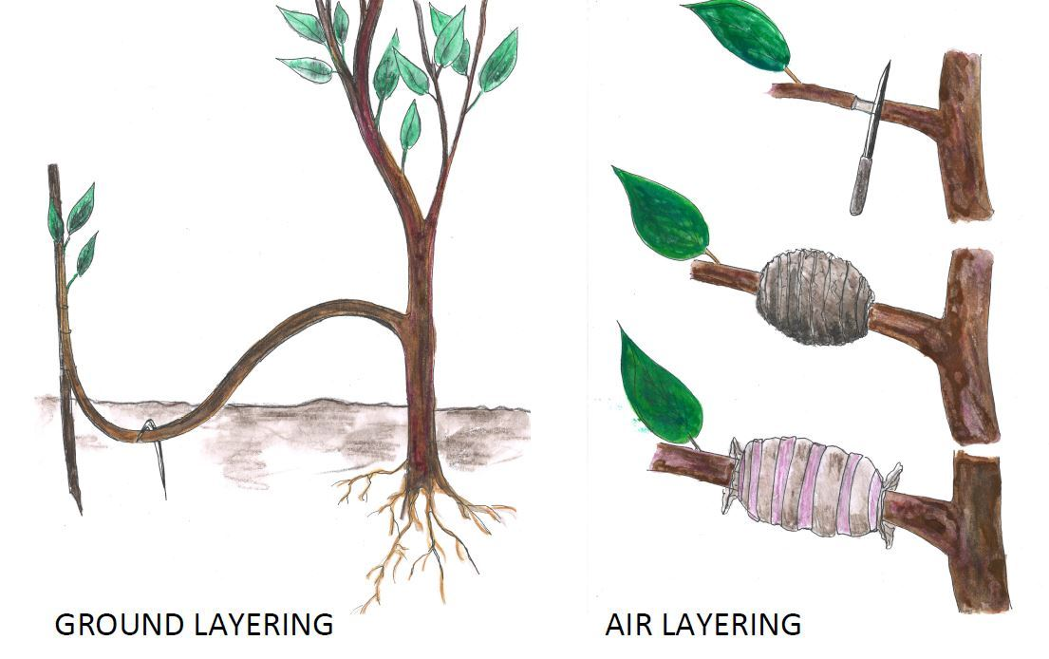
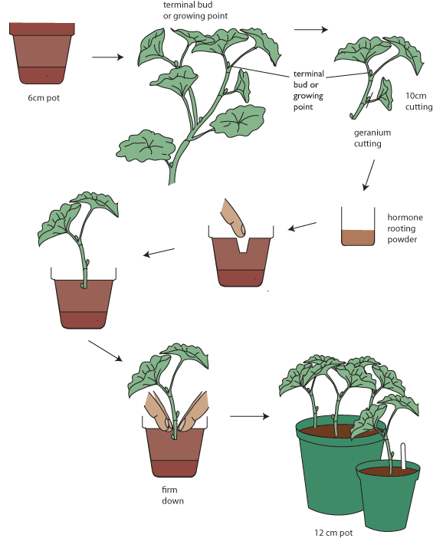
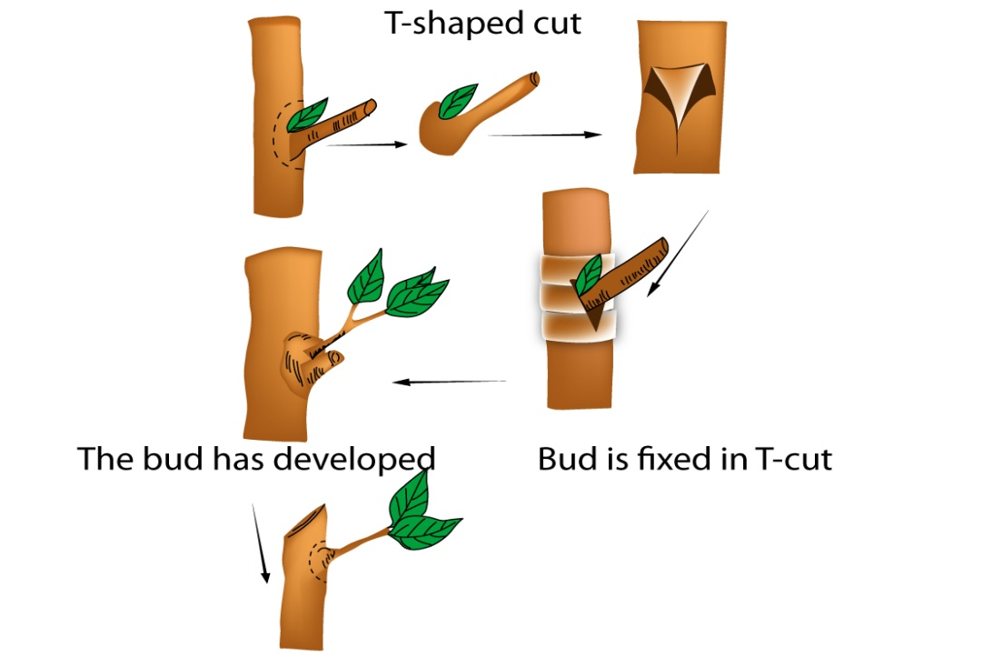
Layering
Grafting
Budding
Cutting

Slide 8
SEED PROPAGATION
Seed dormancy
Seed treatment
Conditions for successful propagation
Rising of seed beds
Care of seedling
Transplanting techniques

Slide 9
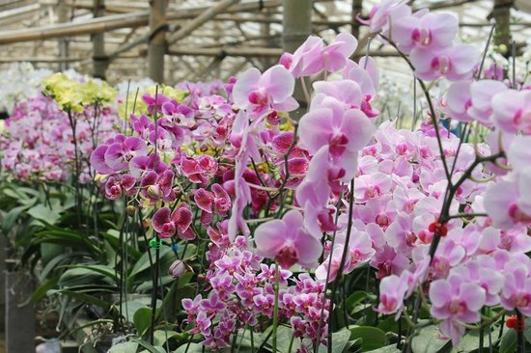
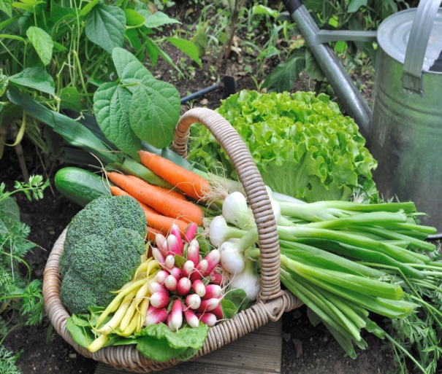
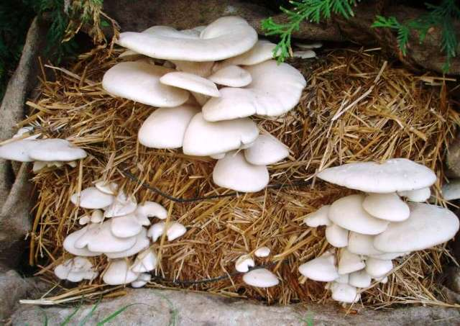
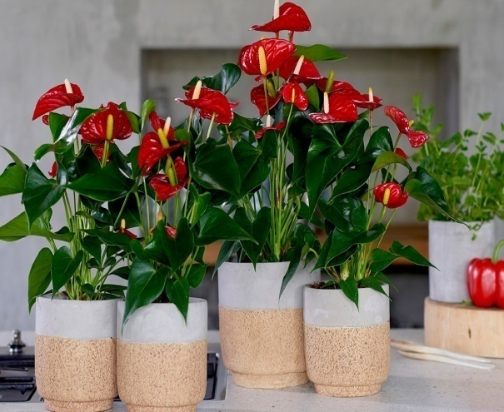
BOTANY IN EVERY DAY LIFE
Vegetable gardening
Mushroom cultivation
Vermi composting- technique
Biofertlizer Technology
Orchid and Anthurium cultivation
Creating Bonsai

Slide 10
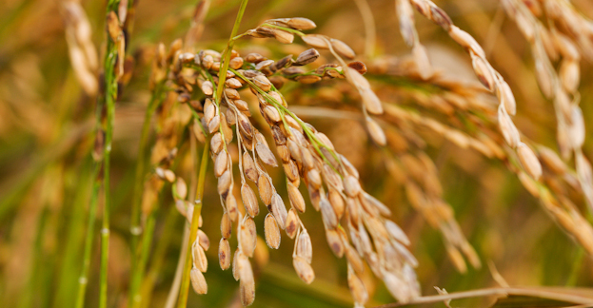
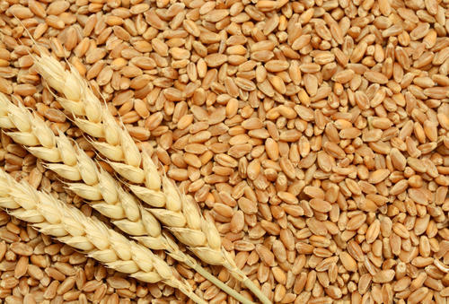
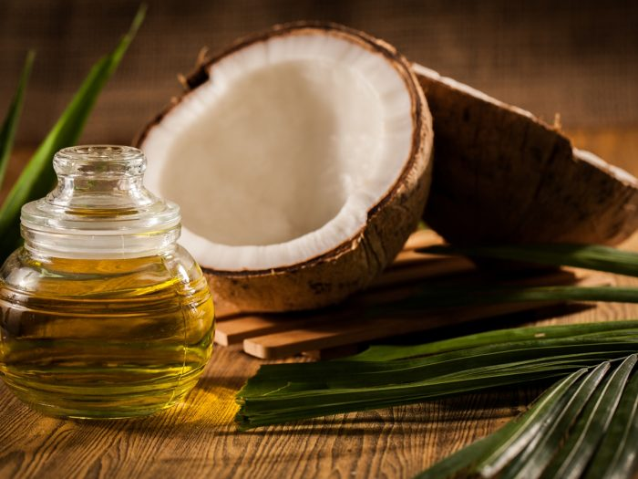
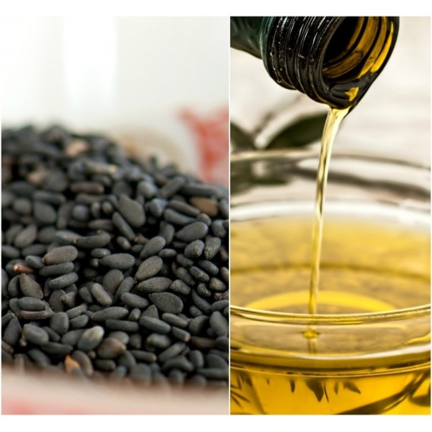
ECONOMIC BOTANY
General account on various plants of economic importance
Rice Wheat Cereals and Millets
Oil Coconut Gingelly

Slide 11
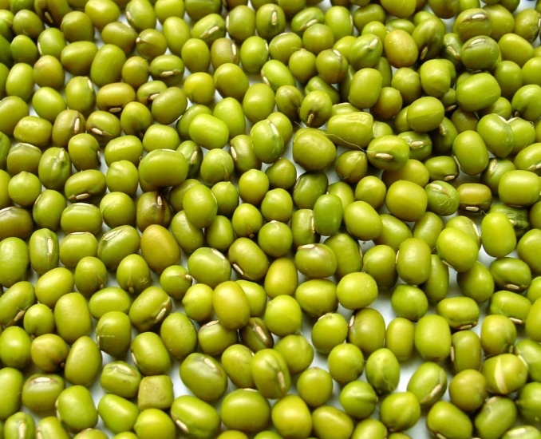
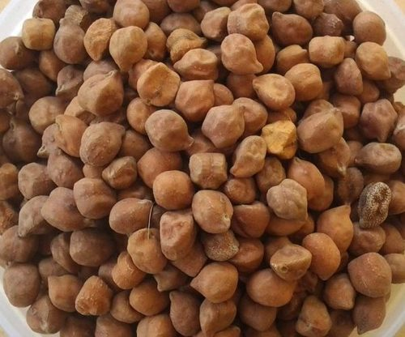
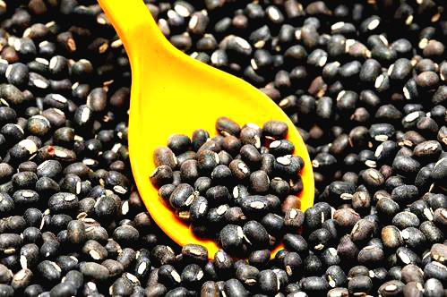
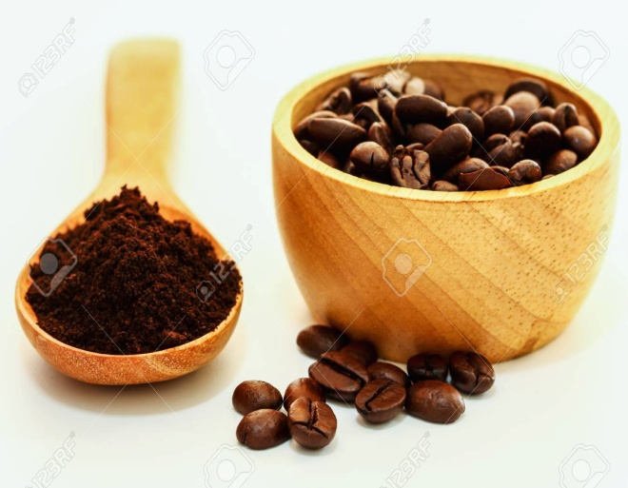
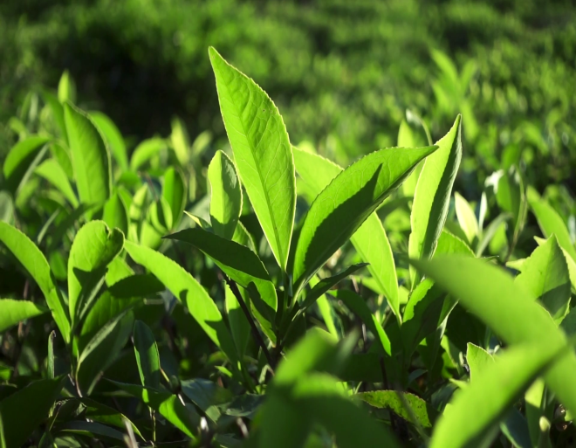

Pulses
Green gram Bengal gram Black gram
Beverages
Coffee Tea Cocoa

Slide 12
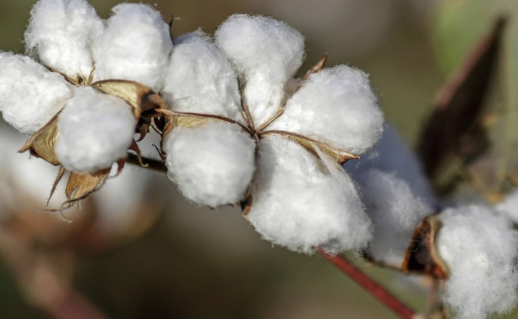
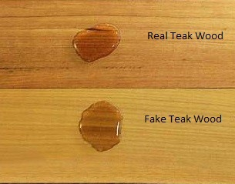
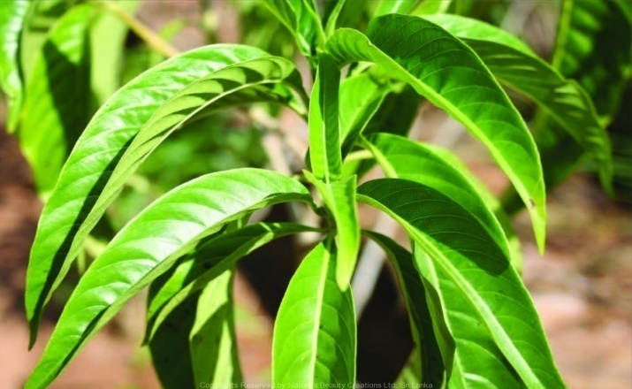
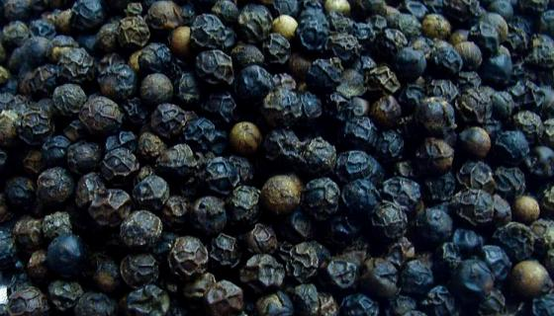
Fibre – Coir, Cotton
Timber – Teak, Rose wood, Jack wood
Spices – Pepper, Ginger, Cardamom
Medicinal – Adhatoda, Phyllanthus, Rauvolfia

Slide 13
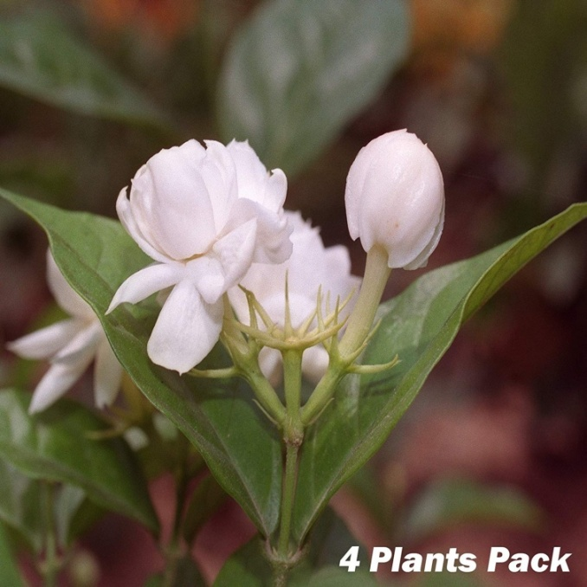

Ornamental plants of economic importance

Slide 14
SCOPE OF THE COURSE:
Employment for skilled people
Supports industries like fertilizers, chemicals, machineries and implements
Source of food
Beautifies environment
Arouses our aesthetic imagination

Slide 15
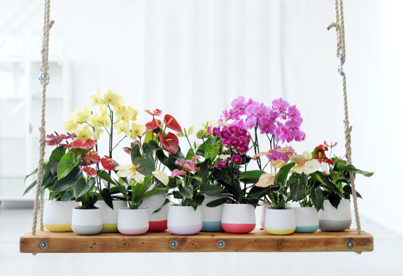
Thank you….
We cordially welcome you all….

