Slide 1
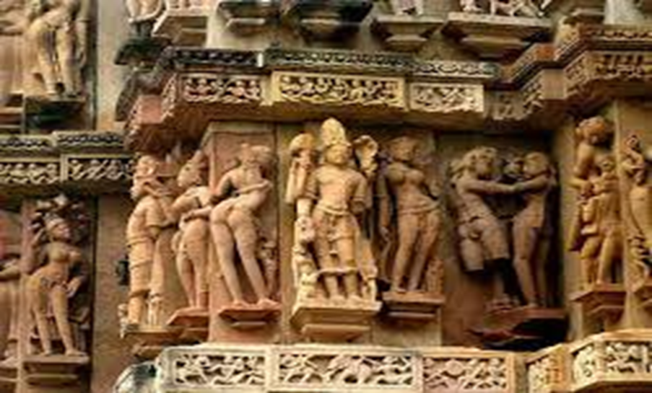
DEPARTMENT OF HISTORY Open Course HIS5D01 HISTORICAL TOURISM

Slide 2
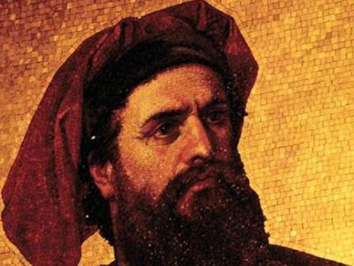
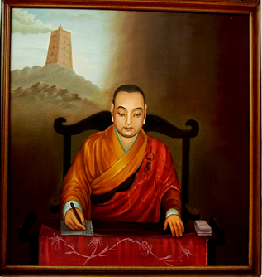
MODULE -1 HISTORICISING TRAVEL IN INDIA
EARLY TRAVELLERS &TRAVELOGUES
Ancient –Megasthenes,Pliny,Fa-hien
Medieval- Marcopolo ,Ibn-battuta
Modern- Ralf Fitch,Buchanan
Tourism and Economy
Types of Tourism

Slide 3
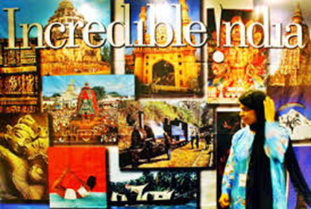
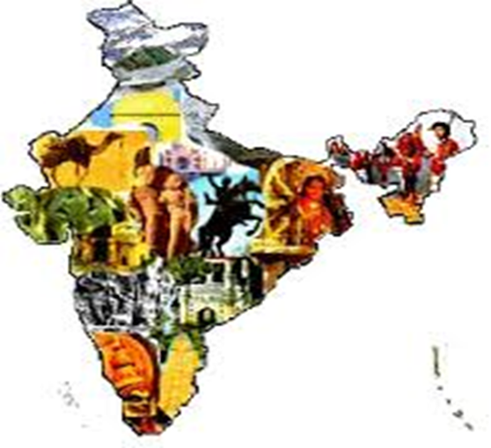
MODULE –II TOURISM POTENTIAL OF INDIA -RELIGIOUS -Puri,Haridwar,Ajmer,,Velankanni -CULTURAL -Santinikethan,Wardha -HISTORICAL -Udayagiri,Edakkal,Hampi -LANDSCAPE -Shimla,Alapuzha -SANCTUARY -Gir, Silent valley

Slide 4


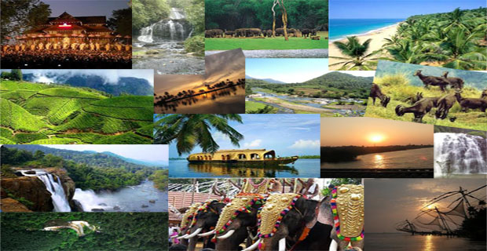
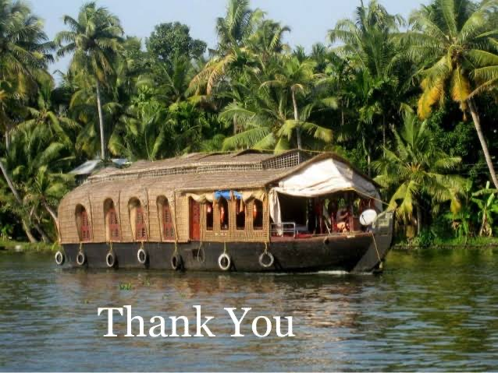
MODULE –III KERALA AS A TOURISM DESTINATION Natural & Cultural Heritage Forts, Palaces, Hill stations etc. Pilgrim Centers, Fairs ,Festivals Etc.

